Slide 1
ReactJS
about new

Slide 2
It’s aright to:
Ask questions
Ask about new words or terms
Clarify confusing concepts
Relax and have fun
Notes:
Before we start, I highly encourage you to ask questions.
If you have questions or clarifications that you want to ask me, please do not hesitate to raise your hands.
I highly encourage you to ask questions. ReactJS can be very confusing or hard,
even for those who have experience programming.
Third, you are most welcome to clarify things before we proceed with the next topic.
Finally, please relax. Just chill and have fun. Programming can sometimes be difficult but it is what it make it fun too.
This course takes into account that you have no prior knowledge with programming.

Slide 3
First things first …
We already know the basics of Javascript and HTML
We will cover the basics of ReactJS only
We will be building a single page application
Notes:
Assumed that we know the basics of HTML and javascript. We are also familiar with object oriented programming concepts.
Cover the basics only. We will not tackle advanced concepts in React. If we already know React, we had designed this curriculum with newbies in React in mind. We will provide the initial push towards learning, it is up to us to further our knowledge or skill.
We will discuss the overview of how react works but not in detail. We will focus more on how to use React to build a single page application
What we are building is a single page application. We will not tackle server side rendering or lazy loading. We will discuss what is a single page application later.

Slide 4
First things first …
We should know how to use git
Disclaimer: I am not an expert in React.
Google is your friend
Do not give up
Notes:
We should also know how to use git. Activities are checked via github. I'll discuss this later.
Please ask questions. If a concept is confusing, please let me know.
Disclaimer: I am not an expert in React. You might have a question that I can't answer right away, I'll take note of it and answer you after the session.
Google is your friend. React is a new framework. It changes every month. What you may know now is different next few months after.
Lastly, do not give up. Learning ReactJS is hard. It will introduce new programming paradigms that will be completely new to you. So don't give up. Relax and have fun especially when you hit a wall.

Slide 5
Environment Setup

Slide 6
IDE / Text Editor
Use any text editors or IDEs (use what you prefer)
Examples:
VS Code
Atom
Sublime Text
IntelliJ / Webstorm

Slide 7
Git and Github Account
All activities are sent via github
Discuss at the end of the session how to pass activities
Use any git client you want eg. SourceTree, Git Kraken, Tortoise Git

Slide 8
Node Package Manager (npm)
npm is the standard package manager for Node.js.
Used for dependency management
Allows installation of thousands packages / modules
Equivalent to Gradle, Maven, pip, etc
Notes:
The main goal, as you touched upon, is automated dependency and package management. This means that you can specify all of your project's dependencies inside your package.json file, then any time you (or anyone else) needs to get started with your project they can just run npm install and immediately have all of the dependencies installed. On top of this, it is also possible to specify what versions your project depends upon to prevent updates from breaking your project.

Slide 9
Node Package Manager (npm)
Installs the dependencies by running the command npm install
Looks for package.json in the project directory

Slide 10
Node Package Manager (npm)
What is a package?
A package contains all the files you need for a module.
Modules are JavaScript libraries you can include in your project.

Slide 11
Node Package Manager (npm)
How do you download a package?
You can download it manually but it is tiresome
Use npm and install it in app
Example:
You want to install react-mic
npm install react-mic
Add --save to automatically save to package.json
Notes:
Show demo

Slide 12
Node Package Manager (npm)
How do you use the package?
Old way:
const rm = require('react-mic);
ES6 way:
import { ReactMic } from 'react-mic’;

Slide 13
Tip:
To make development easier, search for libraries that will help you in development.
Notes:
Think of DRY and WET principles

Slide 14
Good Tools for ReactJS Development
If you’re learning React or creating a new single-page app, use Create React App.
If you’re building a server-rendered website with Node.js, try Next.js.
If you’re building a static content-oriented website, try Gatsby.
Notes:
We will not be discussing the other tools. We will be focusing on Create React App since we are building a Single Page App.

Slide 15
create-react-app
Github Repository https://github.com/facebook/create-react-app
A node module that allows us to build single page ReactJS application quickly
It is also ideal for learning ReactJS
Maintained by Facebook
Notes:
Create React App is a comfortable environment for learning React, and is the best way to start building a new single-page application in React.
Typically, you need to use a bundler like webpack to start using ReactJS. It creates an abstraction wherein you get to make ReactJS apps right away.
Also endorsed/suggested by Facebook.

Slide 16
create-react-app
How do I install create-react-app?
npm install -g create-react-app
-g stands for global (it will be installed in your PC and not your project)

Slide 17
create-react-app
How do I create and start a project in create-react-app?
Run the following lines:
npx create-react-app <name of your app>
cd <name of your app>
npm start

Slide 18
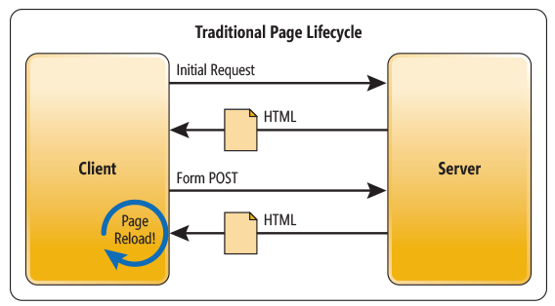
Traditional Web Application

Slide 19
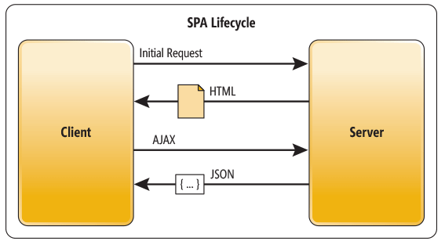
Single Page Application

Slide 20
Summary
NPM is used for installing libraries/modules for project
create-react-app is used for starting react projects that are single page applications right away

Slide 21
Tools Used in this Training
Text editor of your choice
npm for installing create-react-app and other modules
git

Slide 22
Activity 1
Before starting do this first:
Login to your GitHub account
Fork the repository below https://github.com/bryancabansay/react-training using github
Clone your fork to your PC
Read and follow the instructions found in activities/instructions.txt

Slide 23
Activity 1
Create a new branch from master named activity/<folder name based on instructions.txt>
Example: activity/jappleseed
Checkout to your new branch
Work on the activity
Save your work in your folder

Slide 24
Activity 1
Commit your changes (Commit message should contain the words “Activity <number of the activity>”
Example: Activity 1 – First commit
Push changes to your fork
Create a pull request

Slide 25
Activity 1
Requirement:
Create a ReactJS application using create-react-app and save to your folder.
It should say:
“Hello World, I am <YourName>!”

Slide 26
Javascript Basics ECMAScript 6 (ES6)

Slide 27
ECMAScript 6
Also known as ES6 and ECMAScript 2015.
New syntax for Javascript
Nice training site for Javascript: https://javascript.info/
Babel is used to convert ES6 to old Javascript
Notes:
Before we start learning ReactJS we will need to familiarize ourselves with basic javascript because it might get confusing if we are not able to follow the syntax
Please note that we will be using a new form of Javascript which is EcmaScript 6 (ES6). Typically, current browsers are not able to read ES6. We are using Babel, a javascript compiler/transpiler to convert our code to old javascript.

Slide 28
JSON – Javascript Object Notation
Data is in name or key/value pairs
Data is separated by commas
Curly braces hold objects
Square brackets hold arrays
Notes:
JSON is short for JavaScript Object Notation, and is a way to store information in an organized, easy-to-access manner. In a nutshell, it gives us a human-readable collection of data that we can access in a really logical manner.
This also represents an object in Javascript

Slide 29
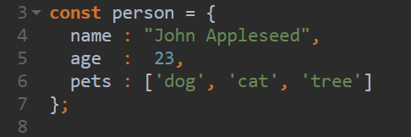
JSON – Javascript Object Notation
Notes:
Data is in name or key/value pairs
Data is separated by commas
Curly braces hold objects
Square brackets hold arrays

Slide 30
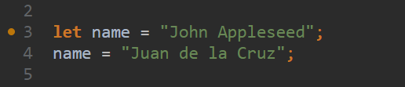
Variable declaration
let allows you to declare variables that are limited in scope to the block, statement, or expression on which it is used.
Use this instead of var
Notes:
let allows you to declare variables that are limited in scope to the block, statement, or expression on which it is used. From now on, practice using let instead of var.

Slide 31
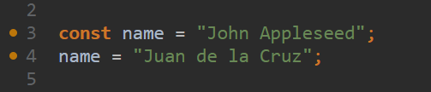
Variable declaration
const is used for declaring constants.
Means you are not able to reassign the variable to another value. But you can mutate the value.
* This will cause an error
Notes:
const is used for declaring constants. This means you are not able to reassign the variable to another value. But you can mutate the value. The code will cause an error since you are reassigning the variable name to another value

Slide 32
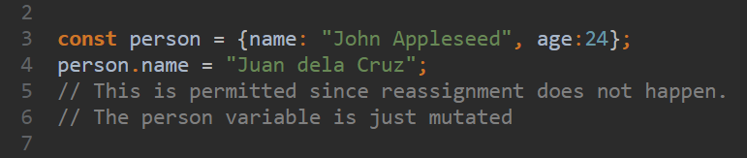
Variable declaration
Notes:
const is used for declaring constants. This means you are not able to reassign the variable to another value. But you can mutate the value. The code will cause an error since you are reassigning the variable name to another value

Slide 33
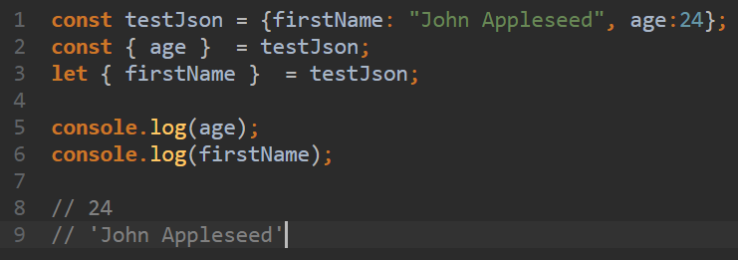
Variable declaration

Slide 34
Arrow Functions
Concise syntax for writing function expressions
Utilizes the => token
Notes:
Also called fat arrows more concise syntax for writing function expressions. They utilize a new token, =>, that looks like a fat arrow. Arrow functions are anonymous and change the way this binds in functions.

Slide 35
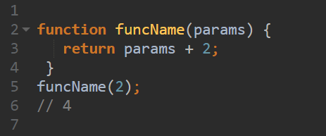
Normal Function
Notes:
Also called fat arrows more concise syntax for writing function expressions. They utilize a new token, =>, that looks like a fat arrow. Arrow functions are anonymous and change the way this binds in functions.

Slide 36
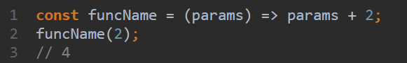
Arrow Function

Slide 37
Arrow Function Patterns
(parameters) => { statement/s }
() => { statement/s }
parameter => { statement/s }

Slide 38
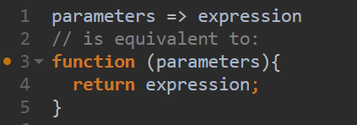
Arrow Function Patterns

Slide 39
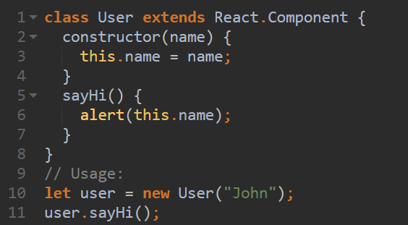
Class Declaration

Slide 40
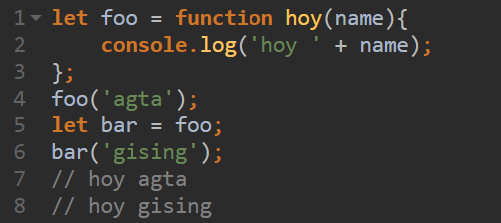
Pass Functions as Variables

Slide 41
Summary
We will be using ES6 syntax.
JSON is used for describing objects in Javascript
Use let for variables that are not reassigned. Use const for non changing ones.

Slide 42
Summary
You can use arrow functions [ => ]
Javascript allows creation of classes and other OOP principles
You can pass functions as variables in JS

Slide 43
Useful Videos
https://www.youtube.com/watch?v=ZNbFagCBlwo
https://www.youtube.com/watch?v=xfGciVdbktI
https://www.youtube.com/watch?v=Jakoi0G8lBg

Slide 44
Useful Videos
https://www.youtube.com/watch?v=ycstRj2i66k
https://www.youtube.com/watch?v=BYbgopx44vo

Slide 45
What is ReactJS?

Slide 46
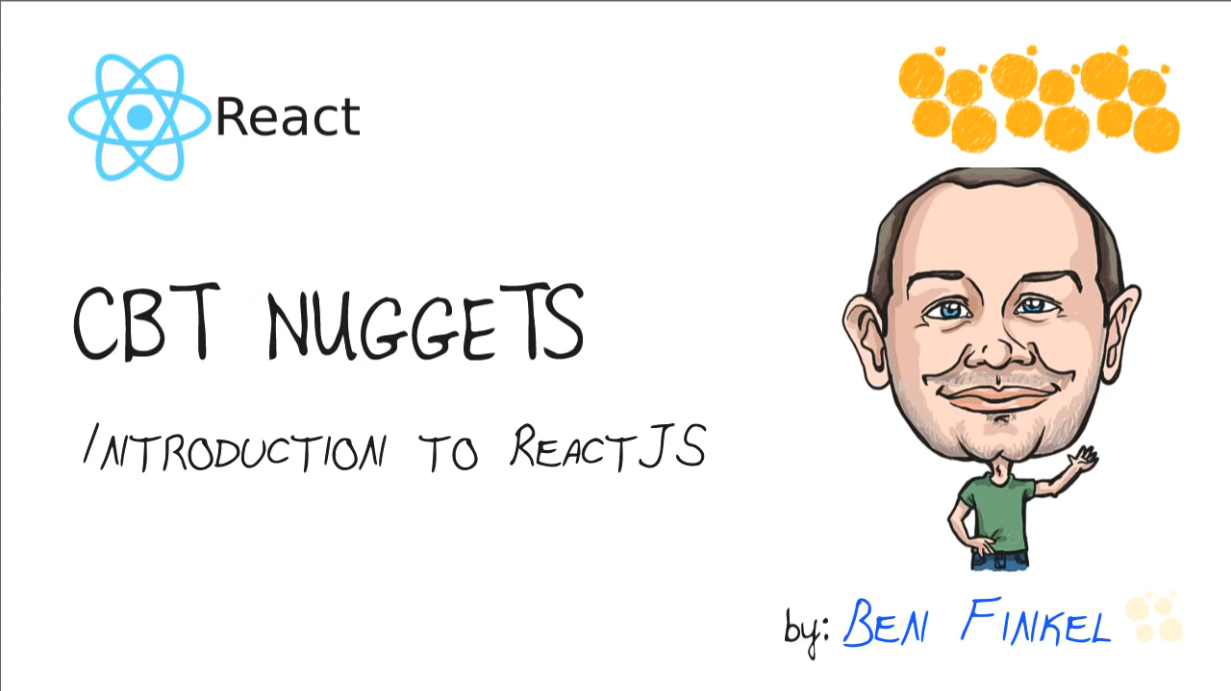
What is ReactJS

Slide 47
What is ReactJS
React is a front-end library developed by Facebook.
It is used for handling the view layer for web and mobile apps.
ReactJS allows us to create reusable UI components.

Slide 48
What is ReactJS
It reacts to changes in the state of the app
Think of the state as the current truth about your application.
Leverages virtual DOM technology (that is why it is fast)

Slide 49
What is Virtual DOM?
DOM stands for “Document Object Model”
Whole html document is a DOM.
Every time there is a change in the state of your application UI, the DOM gets updated to represent that change. Now the catch is frequently manipulating the DOM affects performance, making it slow.

Slide 50
What is Virtual DOM?
The virtual DOM is only a virtual representation of the DOM. In ReactJS it is a very big JSON object.
Every time the state of our application changes, a new virtual DOM is created and is compared with the previous one.
Notes:
The virtual DOM is only a virtual representation of the DOM. In ReactJS it is a very big JSON object.
Everytime the state of our application changes, a new virtual DOM is created and is compared with the previous one.

Slide 51
What is Virtual DOM?
Then the difference calculated so that only parts of the actual DOM affected are updated.
If this process is done using the actual DOM, it would be very slow.
Notes:
Then the difference calculated so that only parts of the actual DOM affected are updated.
If this process is done using the actual DOM, it would be very slow.

Slide 52
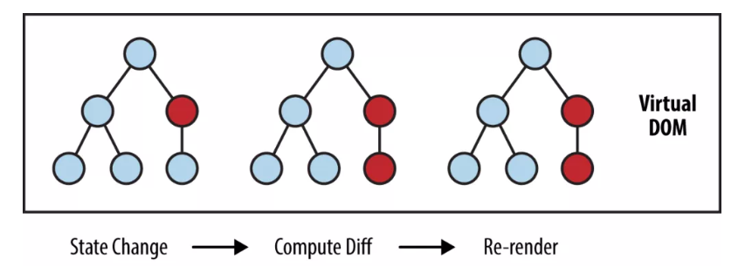
What is Virtual DOM?

